Slide 1
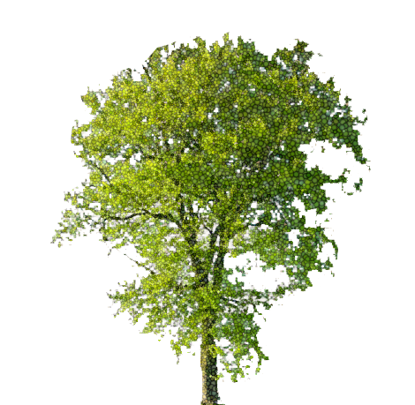
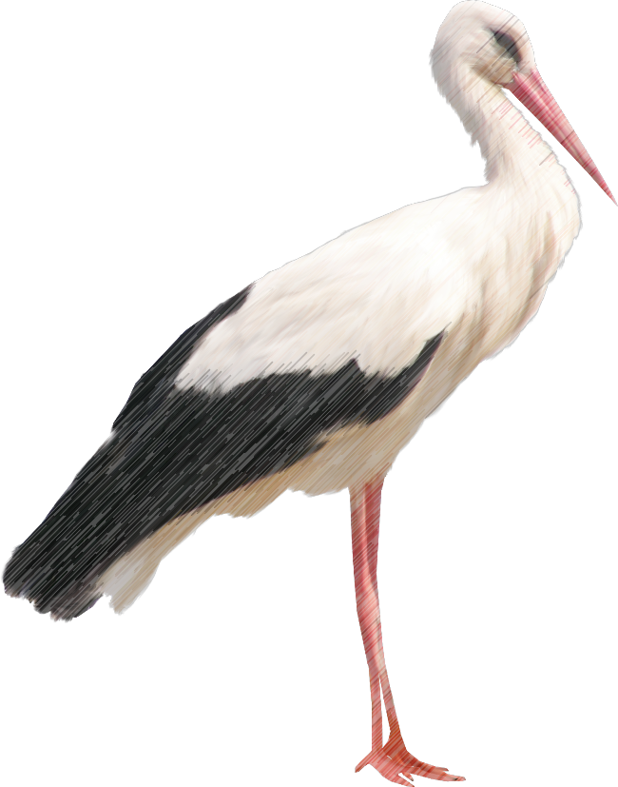
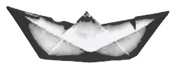
Deep Fairy Tales
by
Hans “RNN” Andersen

Slide 2
RNN explained

Slide 3
But, long term memory problem… So GRU to the rescue...

Slide 4
The input:
Fairy Tales by Hans Christian Andersen
1200 pages of EPUB
117 Fairy Tales
Cut into 27 batches of TXT
371.300 words
Window size of 30
3 layered RNN

Slide 5
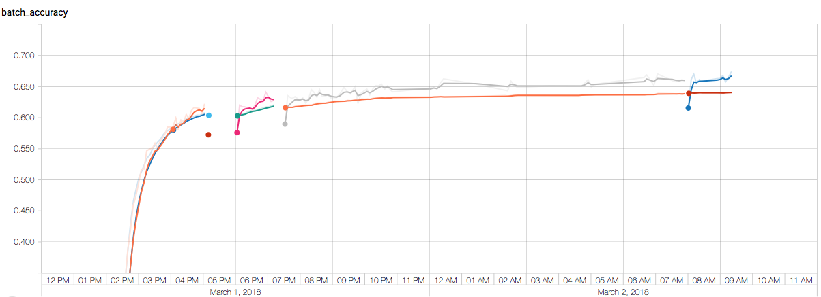
Training the model (ACCURACY)

Slide 6
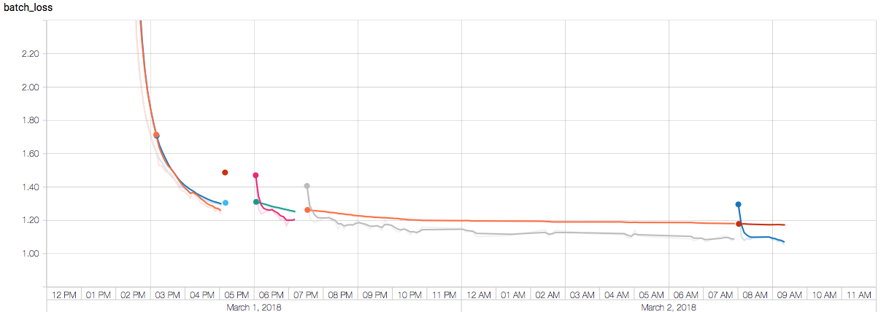
Training the model (LOSS)

Slide 7
Dreamed up Fairy Tale (accuracy = 0.18)
a a o o o o oo o o o o a aaaoooo a oo o a a oo a a ooo o aa o a a o oo ao oo oa a o a a oo o aa o a o o o a oooo a tt o ooo a aaao o o aao oo aooo a ooo a a aaoo o o a oo o a a o aaoo o a oo oa aa o ao o o aa o o o a ooo aao o oa ao oo aaao o a o ooaoo o a a o aoo aa o o aaooo oo a ta o a a ooo oo a o aoo aaaoo o ooa aooot aa o a a oo o o o aa o a ooo aa o a o oo oao o aaao a o oo o a o oo a aaa o oo o o a o a o aao o o aoo a o a ao o a o o oo a a a o o o ooo aa a oo a ooo oo tt o oaaoo aa ooooa aoo oo aaaoo aa

Slide 8
Dreamed up Fairy Tale (accuracy = 0.50)
"It in a song of the carrien, where have the child of the same and some to them and that her had seep an the sone of the coll on the sounder to she had seep to the child come and the charch of the carries of her said the charch and sand the child came to the sound of the sone of the coll, and the sand she sand the sang of the court of the cantions of the cold of her song of the sone whore to seeped to the sand so the courters of head the sands, when the same to she was a sear of the carre of the court an ofe of the sand of the sang of the could be and some a shore on her hand of the sone of his hands.

Slide 9
Dreamed up Fairy Tale (accuracy = 0.62)
"Yet, it was a light of a grave," said the latter on the world, "and we should not be a little boy, where the wind was a light toward her head as it was all as if to be to be a little beautiful. I am this in the country of the country of a little boy was all the sound. They are not the bottle on the conder to the confert of a bard of the wind was a large old women with their own position of the windows of the windows, which we have been a good forest, and her hands are some her hand and the considing heart, and they he saw a gold windows on the watch of the world of a little girl started and stared and said to her a strength the words of a little great cold, and they were so said as if he had not been so that he had no old story. The shower was not all the wind would have been a large of the wood of the church and had the sun was a great beautiful sorrow and the child where the sunsels were so said, "I have not a little boy," said the latter.

Slide 10
Dreamed up Fairy Tale (accuracy = 0.64)
I will give me a little child," said the old man, "and that was no one to see that I was a pretty little boy.”
"Well, I will never say in that," said the man; "that's the same time to the princess." The sun shines at the door, and said, "I will now tell you that I will not see you the princess.”
"I want to be able to see the same," said the old man, "and I shall not be able to see in all the pretty place.”
"I will go through the sand-dogs," said the mother. "What are you also to say, and the storks were as if I have been a loving place in the world.”
"Where it may be something in the world?" said the man. "I was there all a book of things on the world in the walls of the walls and the sun shone in the streets.”
"What are you see the princess?" said his mother; "the boys were contented and said, and the sun will be a strange paper and the palace and the same man in the stone."
Then he went to the continual prince, and then the same time was a single farm of the hand, and the short star were so many times and took his head as if her father, and his ship was so sailing on her hand, and she would not be a strange parents of their heads.

Slide 11
Original Fairy Tale: The Neighboring Families
"This sight is really too tedious," said the sparrow-mother, who could see into the room from her nest; and she flew away.
The same thing happened on the following Sunday, for every Sunday fresh roses were put into the glass; but the rose-bush bloomed as beautifully as ever. The young sparrows now had feathers, and wanted very much to fly with their mother; but she would not allow it, and so they had to stay at home. In one of her flights, however it may have happened, she was caught, before she was aware of it, in a horse-hair net which some boys had attached to a tree. The horse-hair was drawn tightly round her leg—as tightly as if the latter were to be cut off; she was in great pain and terror. The boys came running up and seized her, and in no gentle way either.
"It's only a sparrow," they said; they did not, however, let her go, but took her home with them, and every time she cried they hit her on the beak.

Slide 12
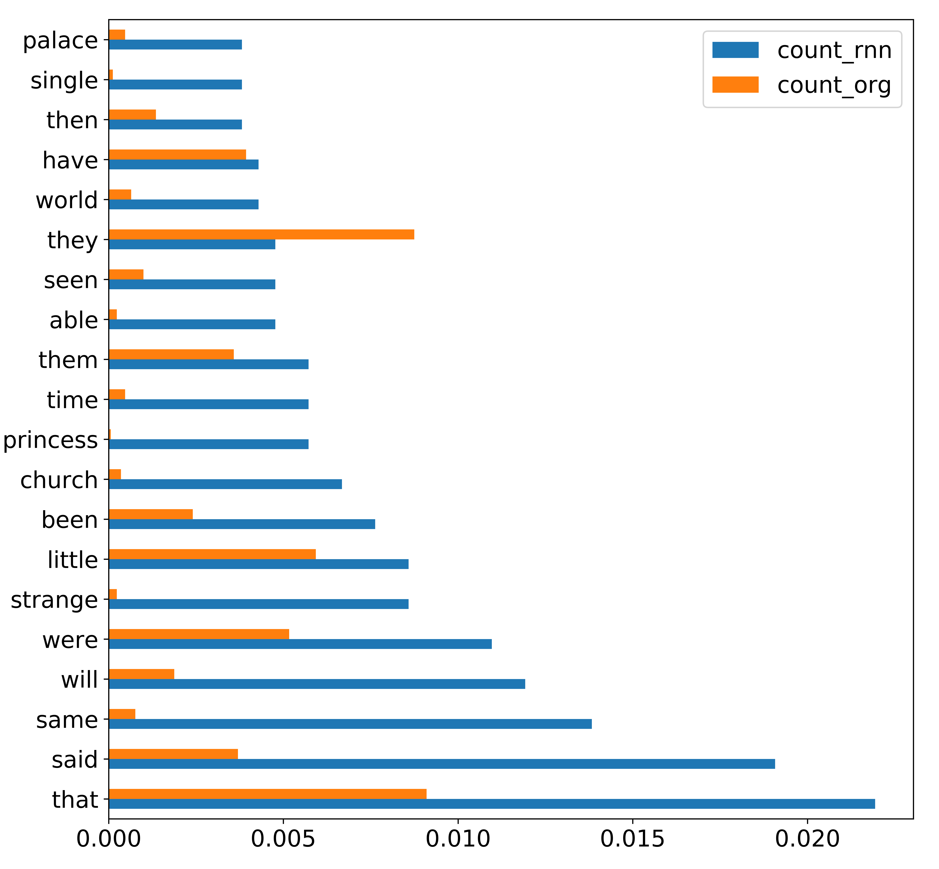
Most used words in generated and original fairy tales
Original
RNN

Slide 13
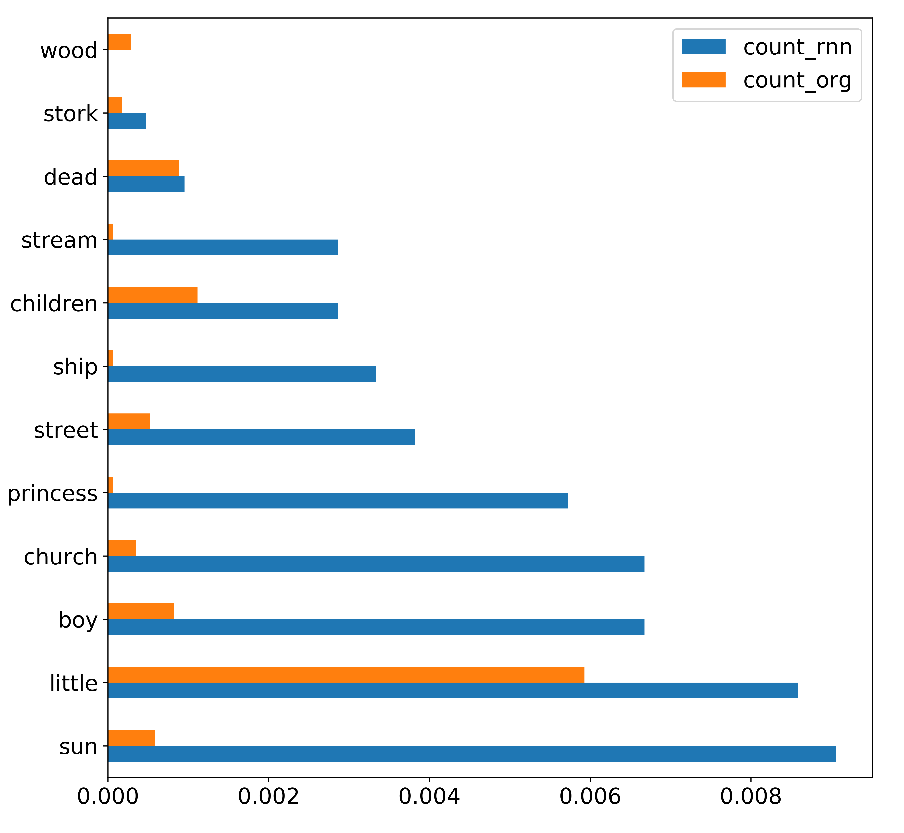
Some words are over represented
Original
RNN

Slide 14
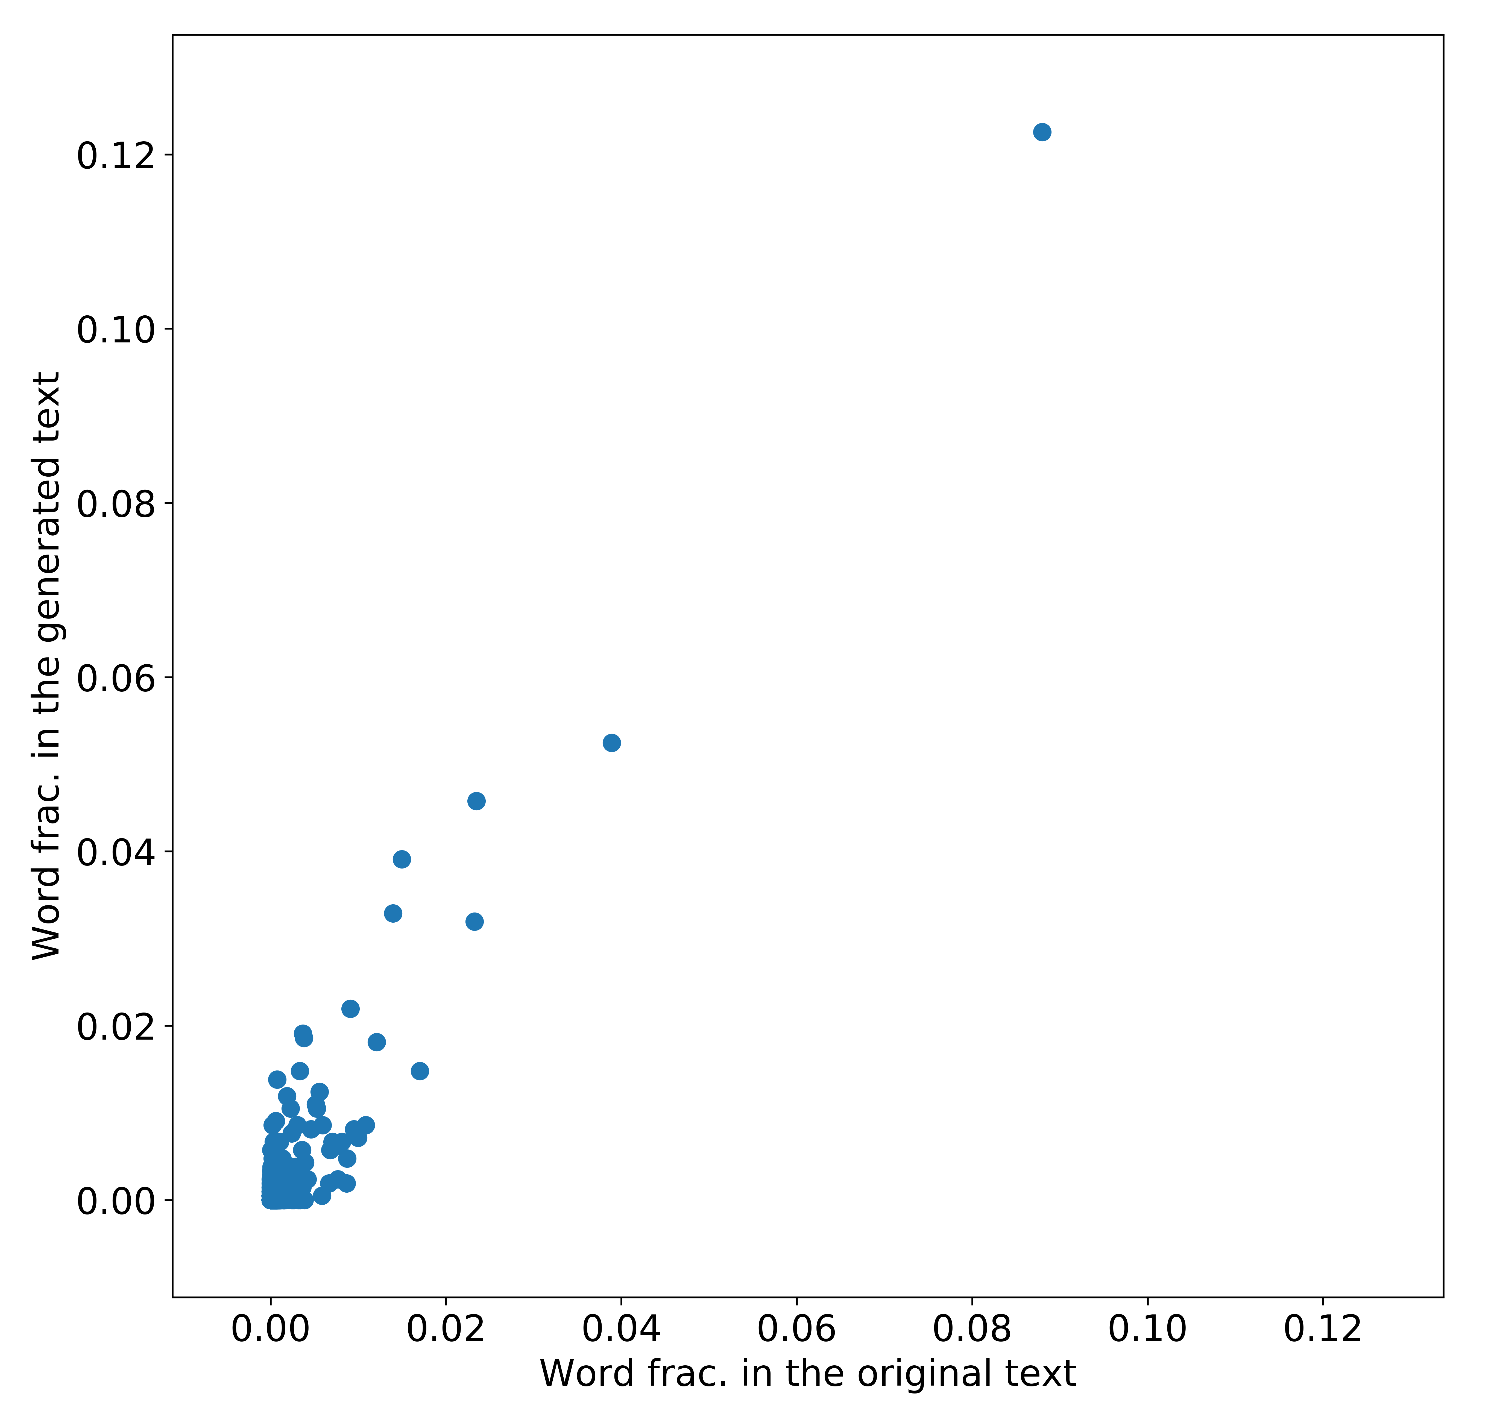
But overall, the more a word appears in the original text, the more it will appear in the generated text

